Slide 1

Heart Rate and SpO2 Monitoring System with Automated Excel Reporting
SARVAJANIK COLLEGE OF ENGINEERING AND TECHNOLOGY
Prepared by :
Ruchit sheta 200420111006
Janvi shah 200420111046
Submitted to : Prof. (Dr.) Ketki C Pathak
Prof. Pritesh N.Saxena

Slide 2
CONTENTS
INTRODUCTION
COMPONENTS SPECIFICATIONS
CIRCUIT DIAGRAM
ADVANTAGES
DISADVANTAGES
APPLICATIONS
REFERENCES

Slide 3
INTRODUCTION
Blood oxygen monitoring, heart rate monitoring, and temperature monitoring are all important in healthcare.
Blood oxygen monitoring involves measuring the oxygen saturation level in a person's blood, which is a critical indicator of respiratory function.
Heart rate monitoring involves measuring the number of times a person's heart beats per minute, which is a critical indicator of cardiovascular function.
All Two monitoring techniques can help diagnose and monitor a wide range of medical conditions, and are important tools for healthcare professionals in providing effective treatment and care to patients.

Slide 4
SYSTEM COMPONENTS
ESP 8266
MAX 30102
OLED DISPLAY (0.98 INCHES)
BREADBOARD
JUMPER WIRES

Slide 5
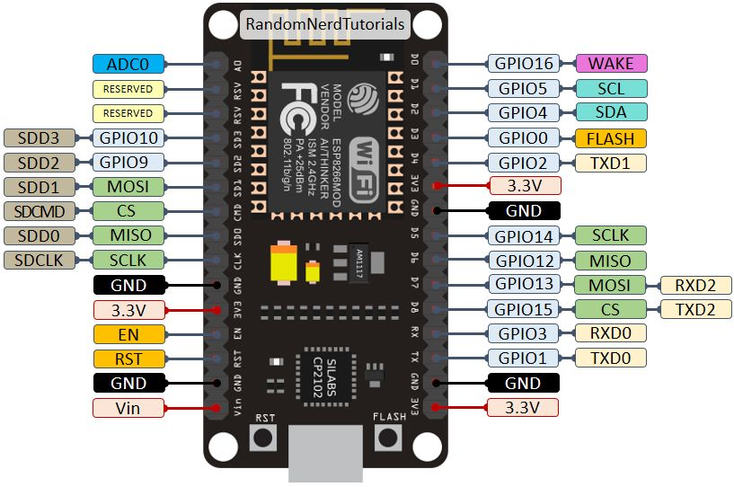
COMPONENTS SPECIFICATIONS
ESP 8266
The ESP8266, which is a low-cost Wi-Fi module that is commonly used in Internet of Things (IoT) projects.
The ESP8266 has a built-in Wi-Fi module and can be programmed using the Arduino IDE, With its small size, low power consumption, and Wi-Fi connectivity.
The ESP8266 is an ideal choice for projects that require remote monitoring and control, such as home automation, smart appliances, and environmental sensing.

Slide 6
I2C PROTOCOL IS USED
I²C (I2C, IIC) is a serial 2-wire bus for communicating with various devices.
ESP8266 chip does not have hardware I²C, so module uses software I²C driver. It can be set up on any GPIO pins including GPIO16.
This module supports :Master mode Multiple buses (up to 10) with different speeds on each bus Standard(Slow, 100kHz), Fast(400kHz)
MAX 30102 supports up to fast (400kHz) I2C communication.
MAX 30102 Sensor has I2C address 0x57.
OLED has I2C address 0x3C

Slide 7
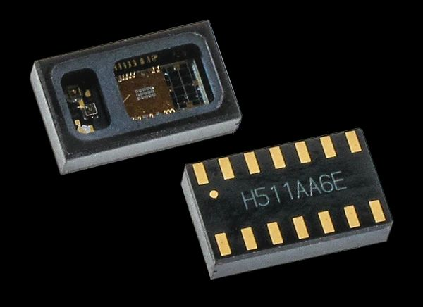
Operating voltage: 1.8V to 5.5V
Integrated photodiode and LED driver
Low-power operation: 600 nA standby current, 4.4 mA active current
Two LEDs for emitting light and one photodetector for measuring light intensity
Digital output (I2C interface)
Adjustable LED brightness for different skin tones and ambient light conditions
Operating temperature range: -40°C to +85°C
Size: 5mm x 6.4mm x 1.5mm

Slide 8
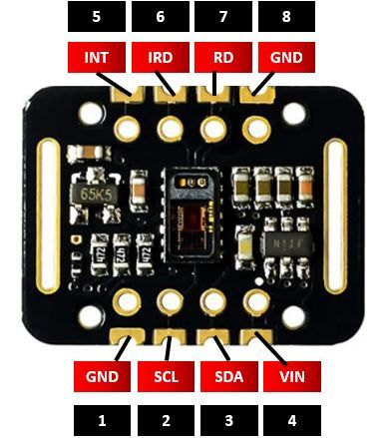
MAX 30102
Pin Description
VIN This pin is used to supply power to the sensor.
This sensor powered on at 3.3-5V.
SCL This is the I2C serial clock pin.
SDA This is the I2C serial data pin
INT This is the active low interrupt pin.
It is pulled HIGH by the onboard resistor but when an interrupt occurs
it goes LOW until the interrupt clears.
IRD IR LED Cathode and LED Driver Connection Point
RD Red LED Cathode and LED Driver Connection Point
GND This is used for supplying ground to this sensor and
it is connected to the source ground pin.

Slide 9
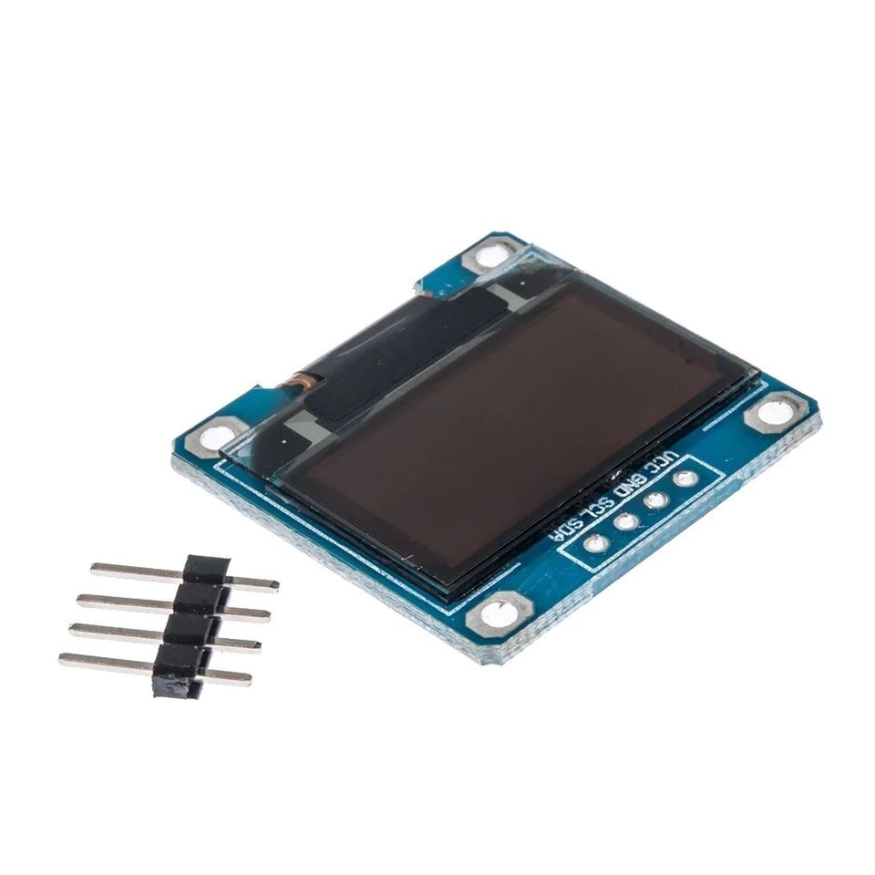
OLCD DISPLAY
0.96-inch (1x1) inch display makes this one of our smaller versions;
perfect for small projects, wearables, and other portables.
It has a low, low 0.06W power consumption in regular working conditions.
Specifications
Display Size: 0.96 inch
Dimension: 26.3x26.1 mm
Display area: 21.7x10.9 mm
Display Driver IC: SSD1315
Resolution： 128x64
Port: IIC Operating
Voltage: 3.3-5V
Display color : Blue, White (Optional)

Slide 10
ESP32 TO GOOGLE SHEETS
Google Sheets come to play as these are free, familiar, and most importantly reliable.
It has a lot of functionalities and built-in integration with many other Google services and APIs.
We can use this for many IoT applications from simple data logging to live monitoring and management of IoT devices.
Steps to create data logger using google spreadsheet.
Create a new Google Sheet.
Create a header row for your data.
Create a Google Script.
Deploy the script as a web app.
Update your ESP32 code to send data to the Google Sheet.

Slide 11
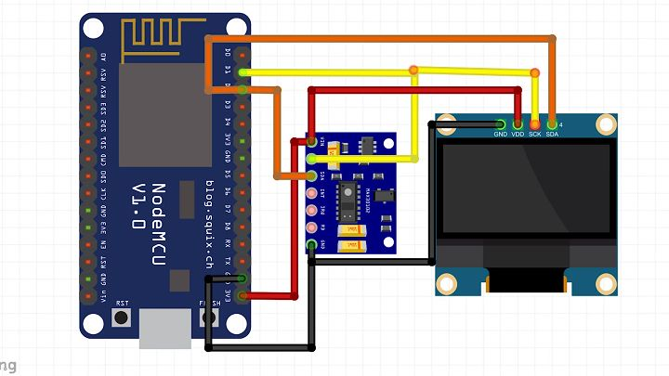
CIRCUIT DIAGRAM

Slide 12
ADVANTAGES
Early Detection of Medical Conditions: Monitoring blood oxygen levels and heart rate can help detect medical conditions early, allowing for prompt diagnosis and treatment.
Non-Invasive: Blood oxygen and heart rate monitoring can be done non-invasively, which means there is no need for needles or other invasive procedures
monitor blood oxygen levels and heart rate using wireless devices. This allows for continuous monitoring of patients in real-time, even when they are away from the hospital or clinic.
Cost-Effective

Slide 13
DISADVANTAGES
False Readings: Monitoring systems may occasionally provide inaccurate or false readings, which can lead to incorrect diagnoses and treatment plans.
Technical Difficulties: Technical issues such as device malfunctions or software errors can cause monitoring systems to fail or provide incorrect data.
Privacy Concerns: Wireless monitoring systems may raise privacy concerns, as they transmit sensitive patient information over the internet or other networks.

Slide 14
APPLICATIONS
Medical Settings: In hospitals and clinics, blood oxygen and heart rate monitoring systems are commonly used to monitor patients with respiratory and cardiovascular diseases..
Sports and Fitness: Athletes and fitness enthusiasts use blood oxygen and heart rate monitoring systems to track their performance and training progress.
Aviation and Aerospace
Military and Defense

Slide 15
REFERENCES
https://www.mouser.com/ProductDetail/Analog-Devices-Maxim-Integrated/MAXM86161EFD+T?qs=XeJtXLiO41T6hWnBlrpJ0w%3D%3D
https://iotdesignpro.com/articles/esp32-data-logging-to-google-sheets-with-google-scripts
https://chat.openai.com/

Slide 16


